Slide 1


Impact and Exploration of Computational Resources on AI Advancements
Carlos Cantu
DSC 680
Notes:
Hello My name is Carlos Cantu
In recent years, the synergy between computational power and artificial intelligence has sparked a revolution across industries worldwide. The exponential increase in computational resources dedicated to training AI models has not only accelerated progress but has also unlocked new frontiers in what AI can achieve. like breakthroughs in natural language processing these developments are reshaping our understanding of technology's potential.
Moreover, the global production of AI hardware, including CPUs and GPUs, plays a crucial role in this narrative. Understanding which countries dominate this industry provides insights into the driving forces behind AI innovation and the strategic investments shaping its future trajectory.
let us explore how these computational resources are not just tools but catalysts for transformation.

Slide 2

The data
Dataset 1 computational resources used for AI model training
Dataset 2 global distribution of AI hardware production
Notes:
The datasets presented here unveil a compelling narrative: the exponential surge in computational resources allocated to training AI models. These resources not only drive technological advancements but also wield significant influence over global markets and geopolitical landscapes. As we scrutinize these datasets, we uncover invaluable correlations between increased computing power and the enhanced capabilities of AI systems.
Dataset 1 unveils the exponential growth in computational resources dedicated to training AI models. This surge not only shines the technological advancement but also shapes the very capabilities that AI systems possess. As computational power expands, so too does the potential for AI to revolutionize industries and redefine societal norms.
Dataset 2 sheds light on the global distribution of AI hardware production, particularly CPUs and GPUs. This dataset reveals not just the geographical centers of technological innovation but also the strategic implications for global markets and geopolitical dynamics. The concentration of AI hardware production in certain regions gives us the interconnectedness of technology, economics, and international relations in the modern era.
However, amoung these datasets' lie critical challenges. Dataset biases and ethical considerations do emerge as focal points that demand rigorous attention. We must scrutinize our data sources and methodologies to ensure the integrity
As we navigate these complexities, let us leverage these datasets to inform, inspire innovation, and foster collaboration across borders.

Slide 3

Initial Discovery
Data size is Modest
AI still in infancy
“CODE” column had irrelevant in both datasets
Headers standardized
Notes:
The two datasets are relatively small Despite their modest size, totaling just 33 rows combined, the initial analysis unveils insights into the nascent stages of AI research and development globally. preprocessing steps involved removing irrelevant data such as "Code" columns from both datasets and standardizing headers for clarity and consistency, These initial findings highlight the infancy of AI technologies and emphasize a strategic significance of early-stage research and development efforts in shaping future techno logical advancements.
I want to note the datasets lack common data points that could facilitate straightforward merging or integration. Each dataset focuses on distinct aspects of the AI realm

Slide 4
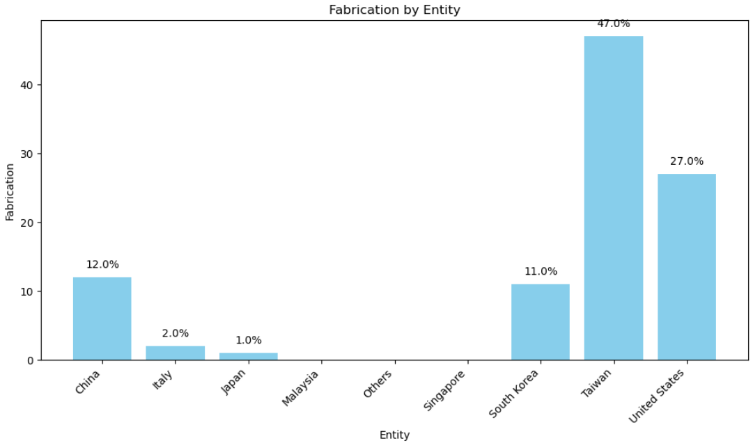

Fabrication
United States & Taiwan control 75% of global chip production
China only non US ally producing AI chips
Notes:
Lets focus and explore the distribution of AI chip production among key nations, this is a critical aspect in shaping global technological dynamics. this analysis pinpoints Taiwan, the United States, South Korea, and China as prominent players in fabricating these essential cpu and gpu components. Taiwan and the United States jointly command an impressive 75% share of global chip manufacturing, proving their pivotal roles in advancing AI technology worldwide. However, it's noteworthy that while the nations and Taiwan teritory are allies, China stands as a notable exception in this production landscape.
This geopolitical dynamic carries significant implications, particularly amidst escalating tensions between the United States and China in 2024. As competition intensifies in the tech sector, these relationships and alliances become increasingly crucial in shaping the future of AI innovation and international dynamics.

Slide 5

Assembly, Testing and Packaging
United States & Taiwan dominate 57% of global assembly, testing and packaging
Allies South Korea, Japan and Malaysia command another 22% of the market
Notes:
Turning our focus to the assembly, testing, and packaging of AI components, a compelling pattern emerges that sets the global distribution of technological capabilities. The United States and Taiwan again collectively dominate an impressive 57% of the market share in this critical sector. Their advanced capabilities in artificial intelligence set them apart significantly on the global stage.
Furthermore, their alliance with South Korea, Japan, and Malaysia commands an additional 22% of the global AI infrastructure market. This collaboration solidifies a substantial portion of the technological prowess concentrated in the Asia-Pacific region.
This concentration not only highlights the leadership of these nations and territory in AI technology but also gives way to their strategic importance in global AI supply chains and competitive landscapes. As these alliances continue to shape the future of technology, their collective strength will play a major role in defining the next wave of innovations and advancements in artificial intelligence.

Slide 6
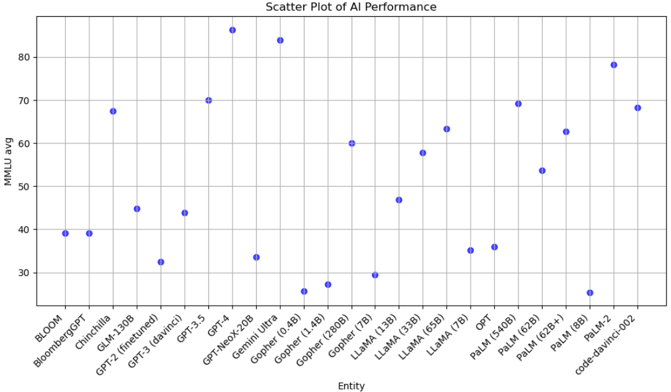
Large Language Model Performance
Mean Multi-layered Understanding
GPT-4 and Gemini Ultra
Only followed by themselves
China is a small Rival to USA
Notes:
Shifting our gaze to the realm of AI technology, specifically Large Language Models (LLMs), we enter a landscape dominated by advanced systems where Mean Multi-layered Understanding (MMLU) serves as a crucial performance metric. Recent assessments highlight GPT-4 and Gemini Ultra as standout leaders in this domain, surpassing their counterparts. Close contenders include PaL-2 from the Gemini family and GPT-3.5, the predecessor to GPT-4.
What's noteworthy is that these leading LLMs are predominantly the products of American innovation, primarily spearheaded by companies like OpenAI and Google. This concentration reflects the significant role of the United States in pushing the boundaries of LLM development and deployment worldwide.
However, amidst this dominance, a notable exception arises with GLM-130B, developed by China. Showing China's active participation and competitive stance in the global AI landscape, contrasting against the backdrop of predominantly American advancements.

Slide 7
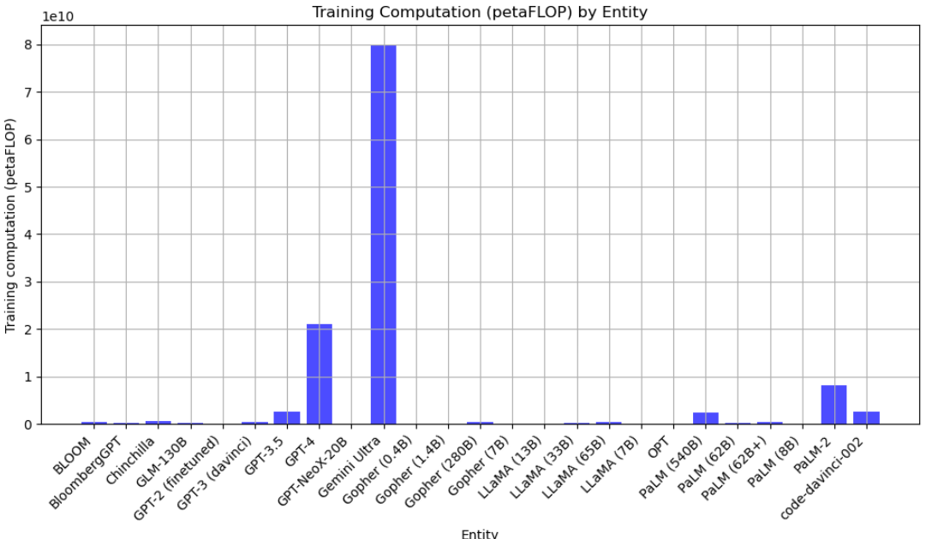

Training Computation
PetaFLOPs = peta floating-point operations per second
Gemini Ultra massive consumption
GPT4 6 petaFLOPs less
Notes:
In our final exploration, we turn our attention to the critical realm of computational resources required for training Large Language Models (LLMs). The demand for computational power hinges on several factors, including the model's complexity, dataset size, and the hardware employed—whether it be CPUs, GPUs, or specialized AI accelerators. These metrics are measured in petaFLOPs (peta floating-point operations per second), crucial for gauging scalability and cost-effectiveness in AI research and development.
A standout in this arena is Gemini Ultra, which commands a substantial training requirement of 8 petaFLOPs, surpassing the combined needs of other models. This significant demand may signify ambitious design goals or highlight challenges in computational efficiency within advanced AI architectures. In contrast, GPT-4, the leading LLM, operates with a more modest requirement of approximately 2 petaFLOPs, reflecting a balanced approach to computational intensity.
the varied computational landscapes shaping AI research, underscoring the importance of efficient resource management in driving future technological advancements. As we navigate these complexities, optimizing computational efficiency remains pivotal for accelerating innovation and advancing the capabilities of Large Language Models.

Slide 8

Thank You
Notes:
Thank you for joining us on this journey through the intricacies of Computational Resources on AI Advancements

